Slide 1
Database system project Mani Mart management system
Course Instructor: Miss Aqsa Umar
Group member
Israr Ahmed (L) (BSE-23F-151)
Qamar Abbas (BSE-23F-072)
Arif Hussain (BSE-23F-053)

Slide 2
INTRODUCTION MINI MART MANAGEMENT SYSTEM
A Minimarket Management System is designed to streamline the operations of a small retail business, providing a comprehensive solution for managing products, customers, employees, suppliers, sales, inventory, and orders. This system aims to improve efficiency, enhance customer service, and provide valuable insights into the business operations through data management and reporting. The following outlines the key components of the Minimarket Management System and their respective functions within an SQL-based database structure.

Slide 3
Components of the Minimarket Management System
Products
Description: Contains information about the items available for sale in the minimarket.
Attributes: Product ID, Name, Category ID, Supplier ID, Quantity, Price, Expiry Date.
Product Categories
Description: Organizes products into different categories for better management.
Attributes: Category ID, Category Name, Description.
Customers
Description: Stores details about the customers who purchase products from the minimarket.
Attributes: Customer ID, Name, Contact Information, Address.
Employees
Description: Manages data related to employees working in the minimarket.
Attributes: Employee ID, Name, Position, Contact Information, Salary.

Slide 4
Suppliers
Description: Contains information about the suppliers who provide products to the minimarket.
Attributes: Supplier ID, Name, Contact Information, Address, Product Supplied.
Sales
Description: Records transactions when products are sold to customers.
Attributes: Sales ID, Customer ID, Employee ID, Date, Total Amount.
Sales Details
Description: Provides detailed information about each sale, including the products sold and their quantities.
Attributes: Sales Detail ID, Sales ID, Product ID, Quantity, Price.
Inventory
Description: Manages stock levels of products within the minimarket.
Attributes: Inventory ID, Product ID, Quantity on Hand, Reorder Level.
Orders
Description: Records orders placed to suppliers for restocking products.
Attributes: Order ID, Supplier ID, Order Date, Total Amount.
Order Details
Description: Contains detailed information about each order, including the products ordered and their quantities.
Attributes: Order Detail ID, Order ID, Product ID, Quantity, Price.

Slide 5
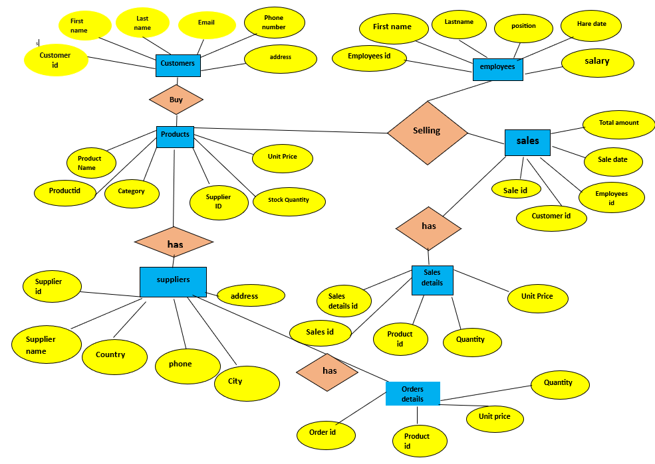
ER MODEL DIAGRAM

Slide 6
Contributions
Israr
Qamar
Arif
15 queries
15 queries
15 queries
ER model
Git hub
ppt
Ppt (1-5)

Slide 7
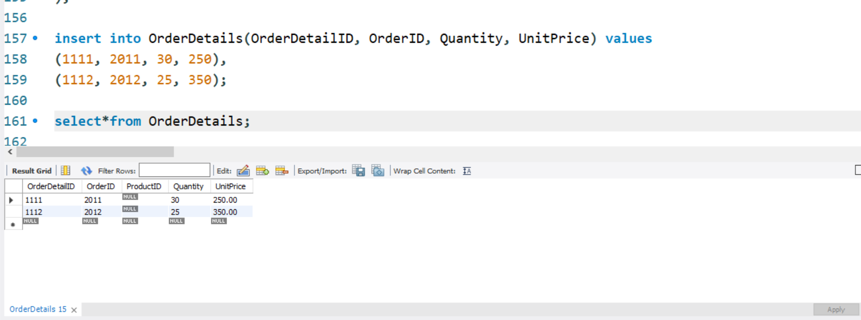
QUERIES

Slide 8
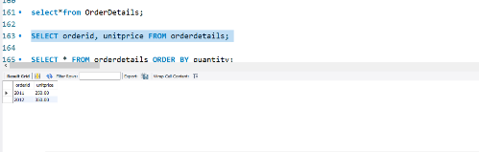
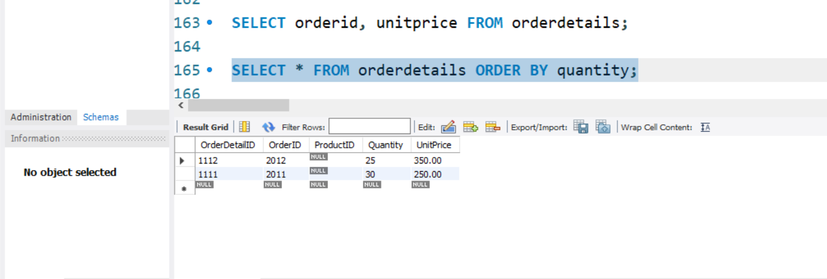

Slide 9
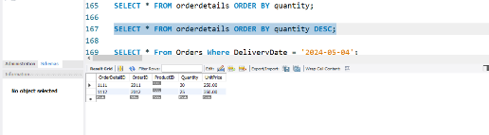
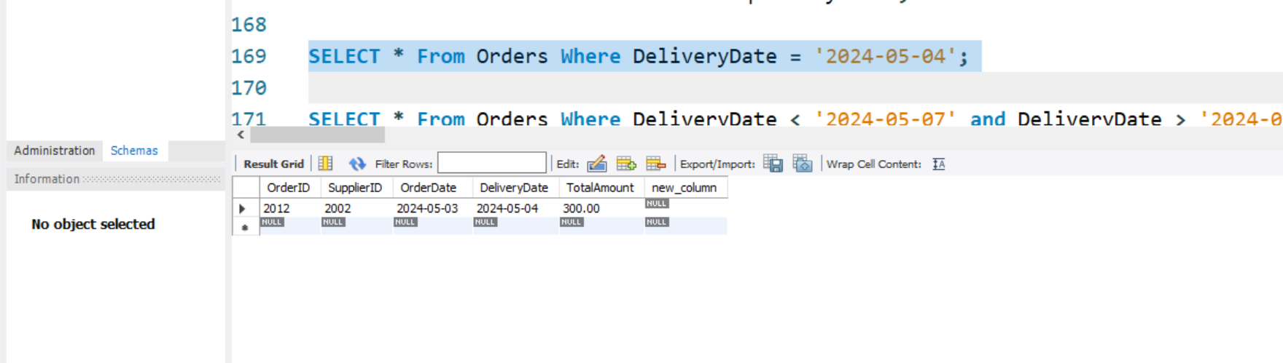

Slide 10
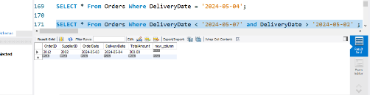
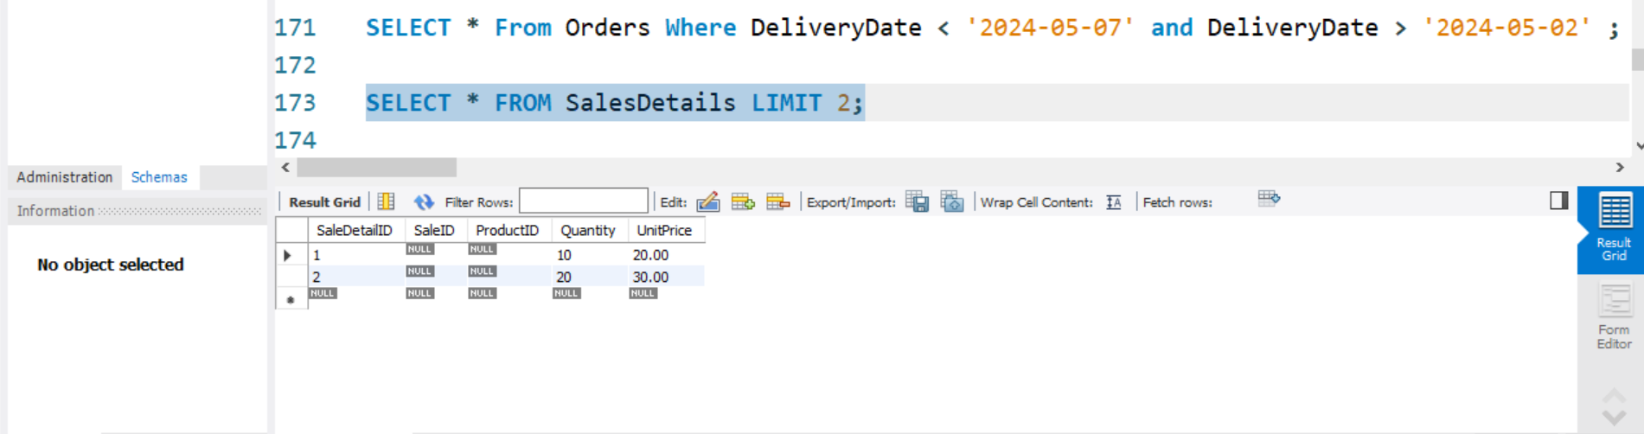

Slide 11
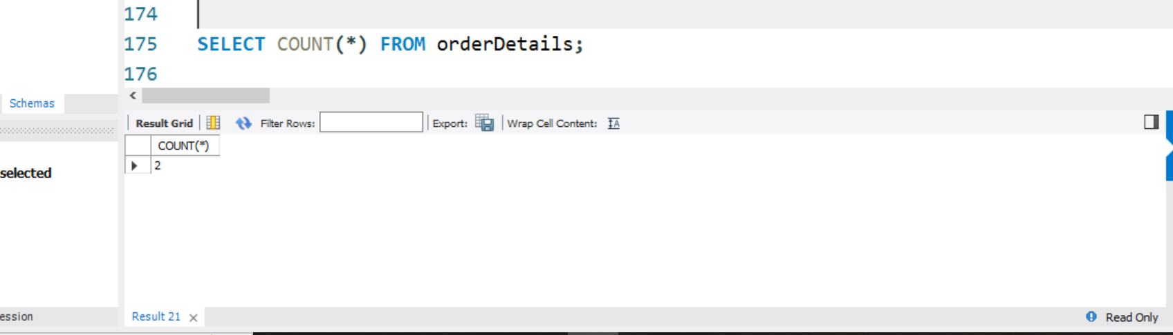
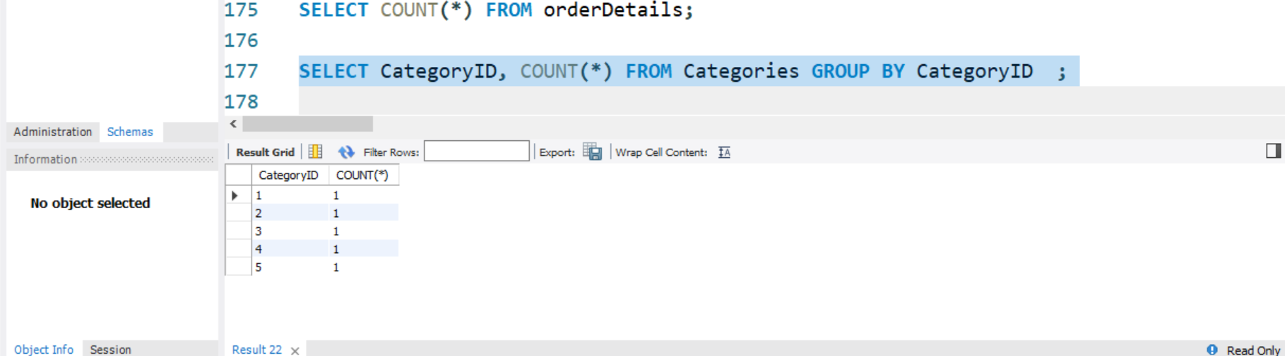

Slide 12
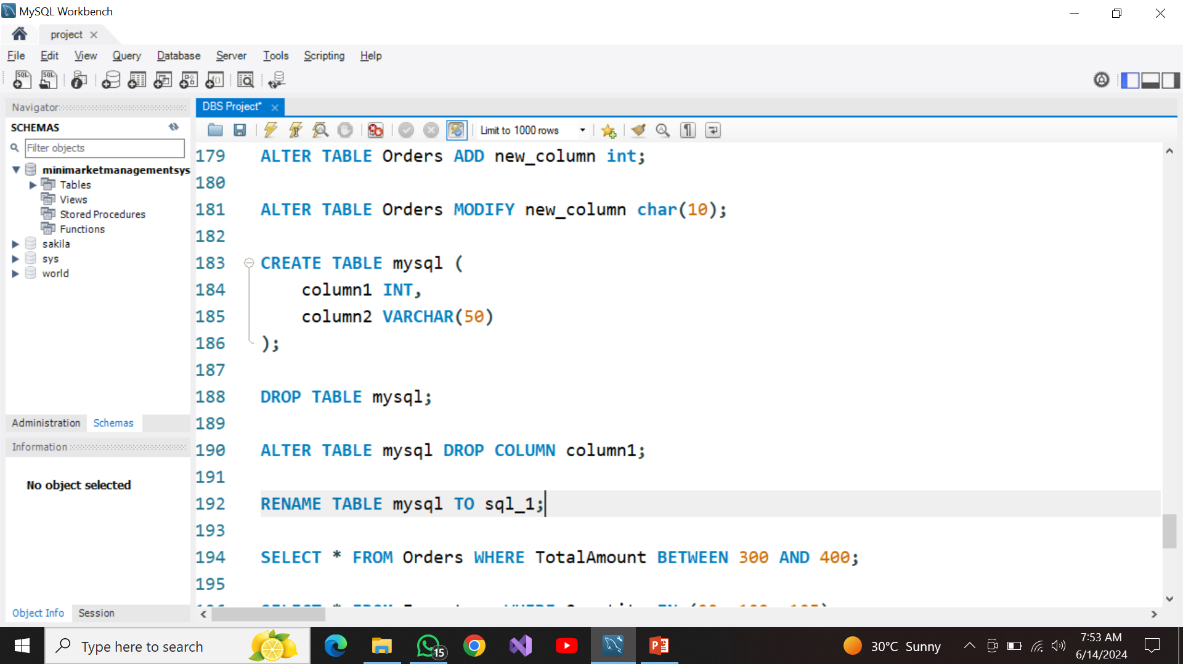
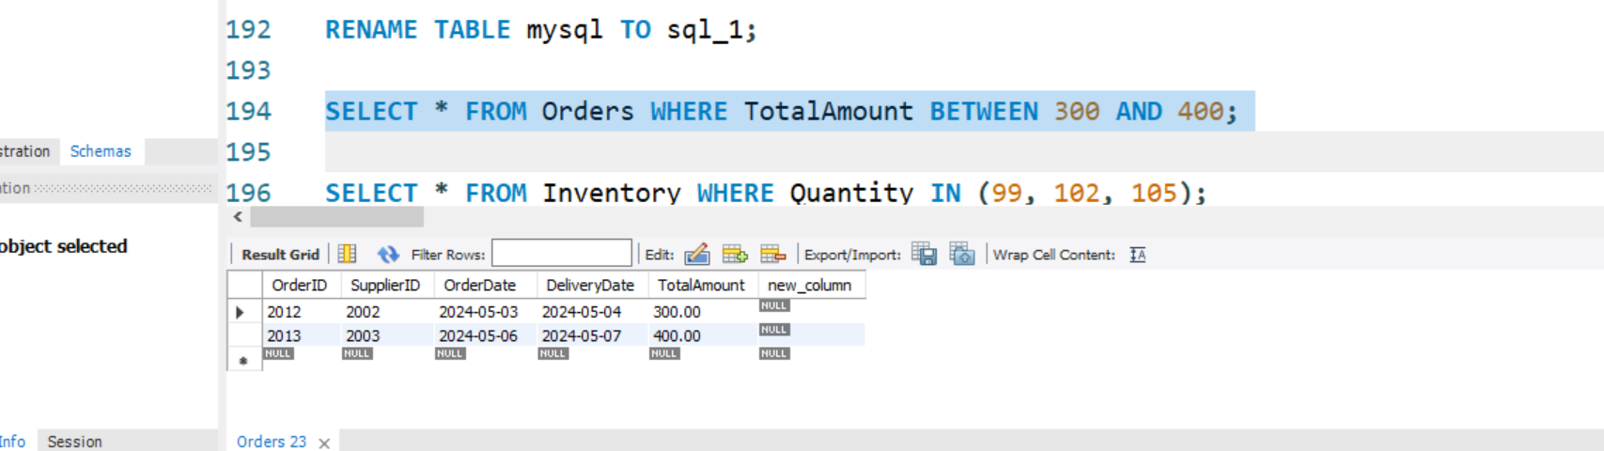

Slide 13
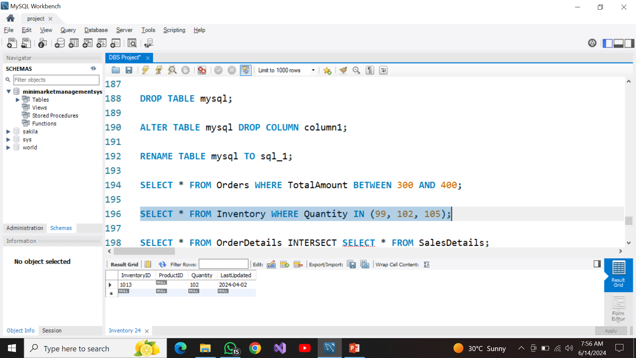
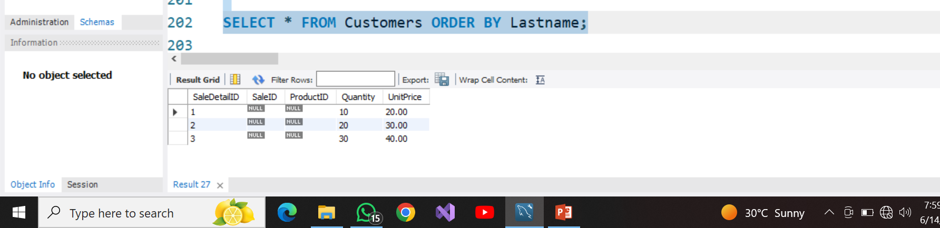

Slide 14
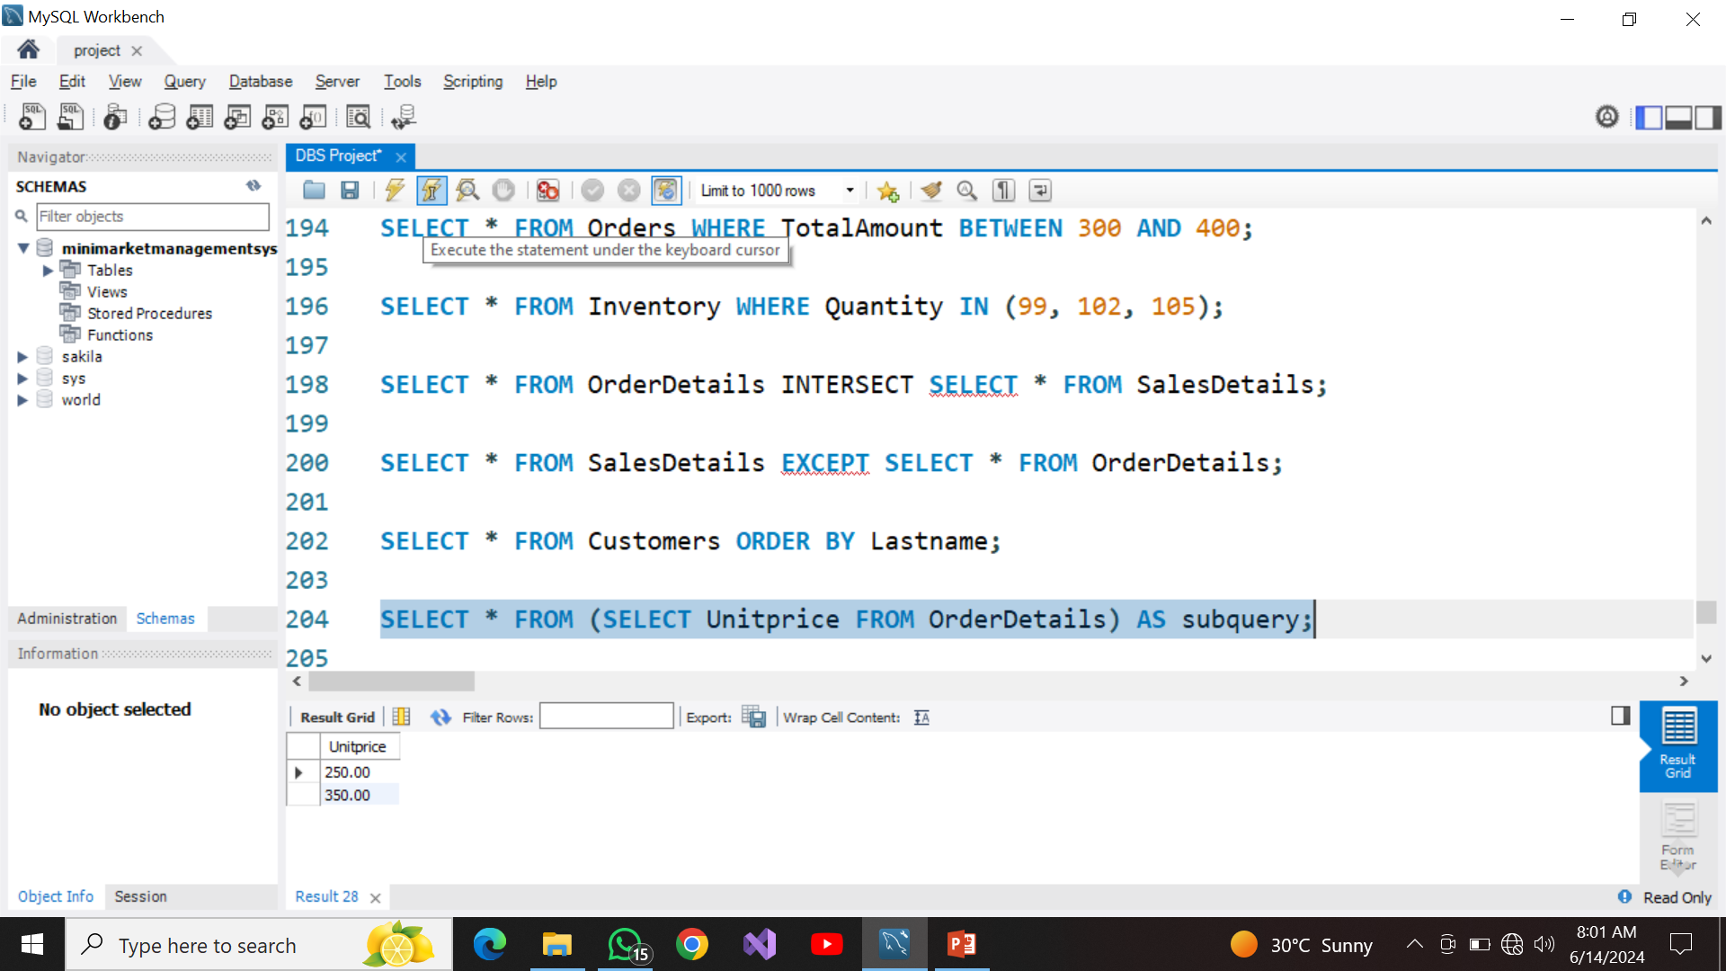
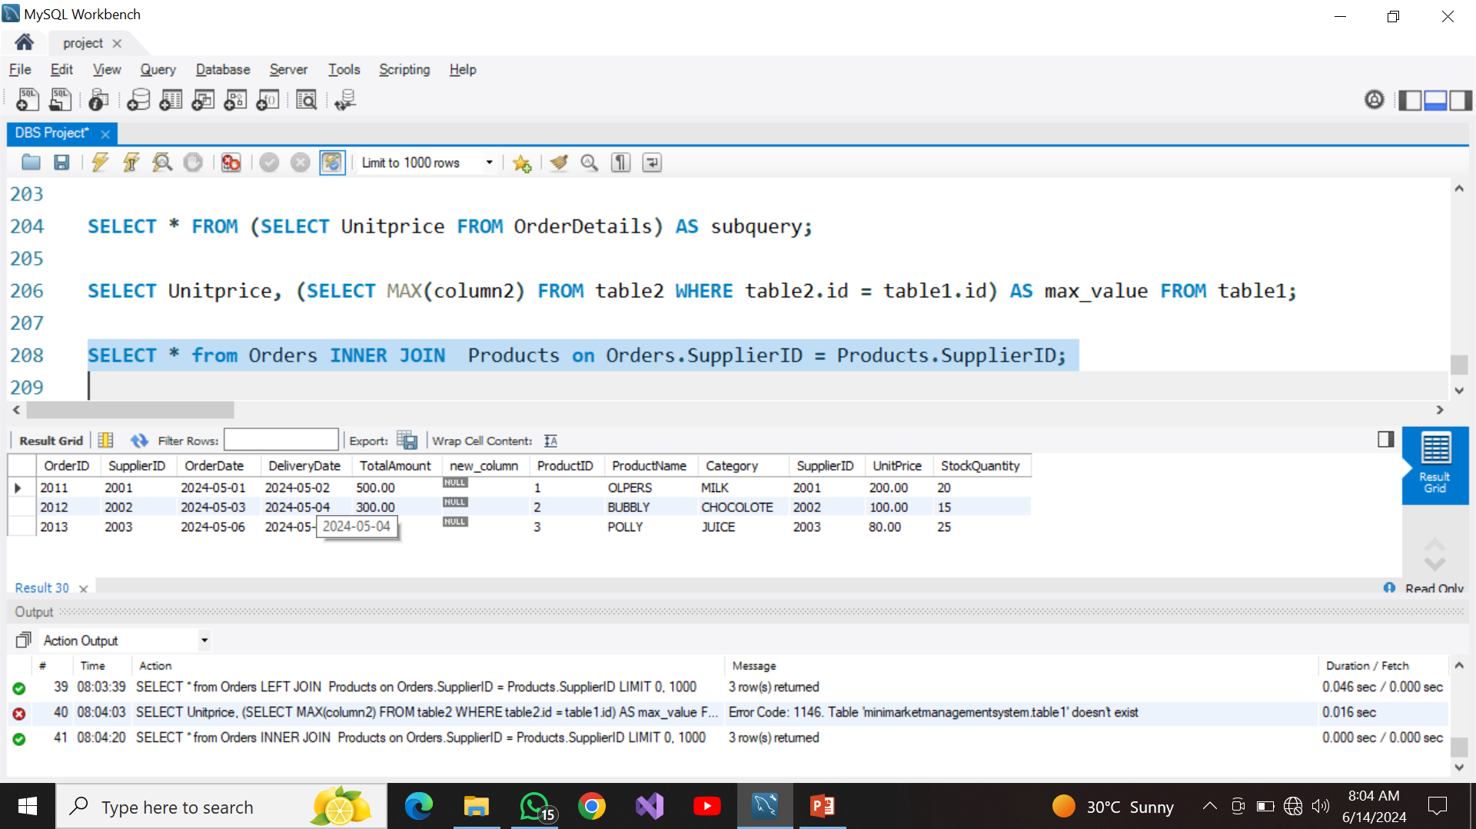

Slide 15
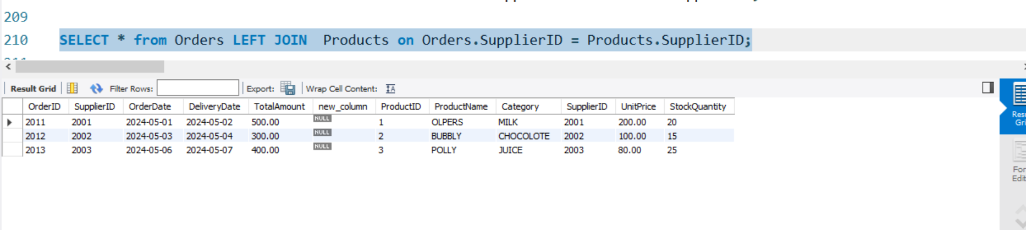
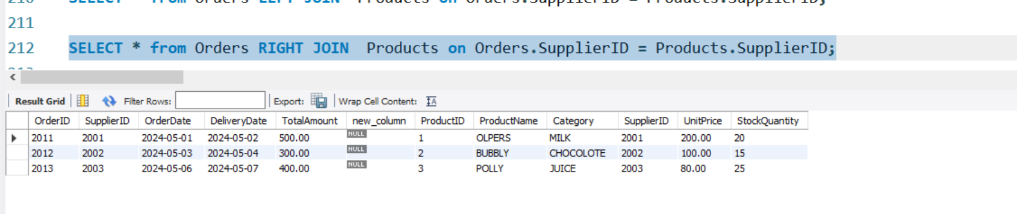

Slide 16
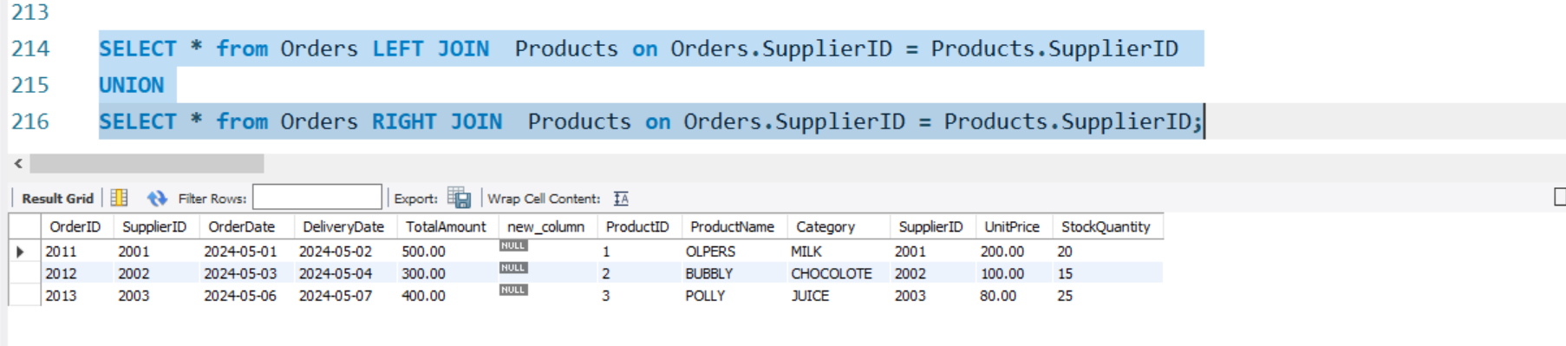

Slide 17
THANKYOU

